Slide 1
Isaac Newton, Gravity, and Orbits
Astro: Chapter 3-5

Slide 2
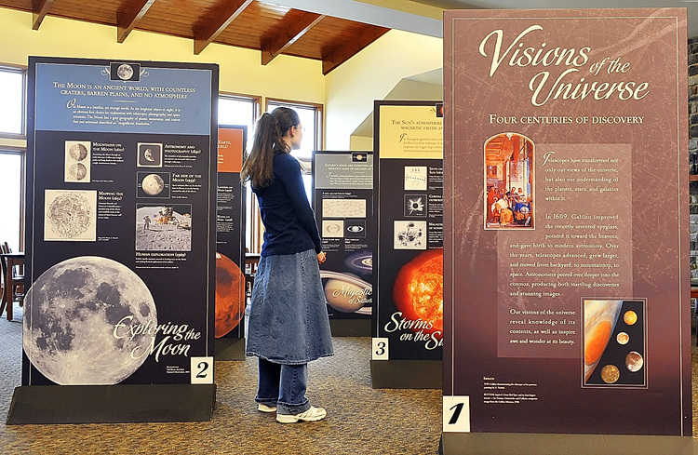
The birth of modern astronomy and of modern science dates from the 144 years between Copernicus’ book (1543) and Newton’s book (1687).

Slide 3
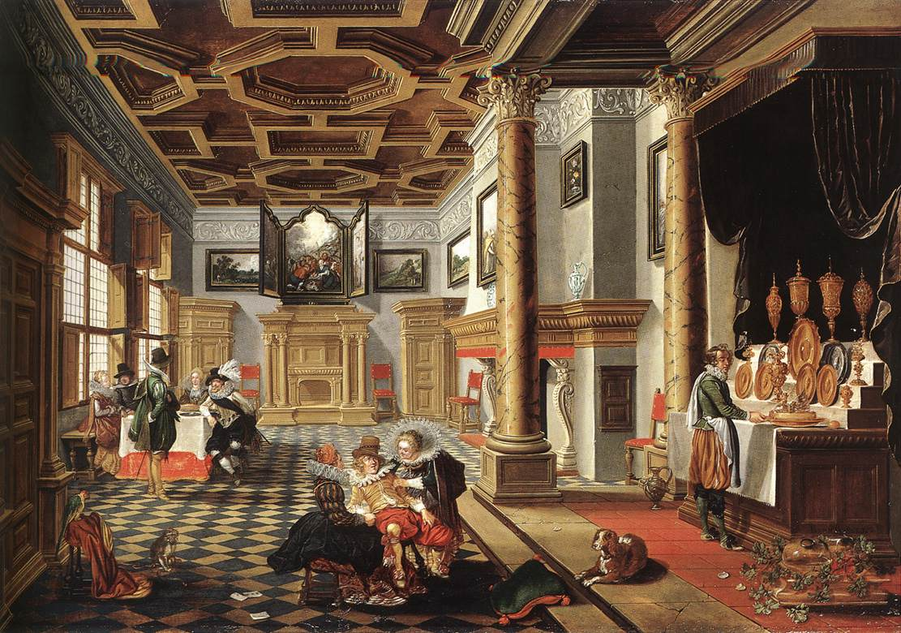
This all occurred during the climax of the Renaissance (the time of major changes or “rebirth” of culture and art)

Slide 4
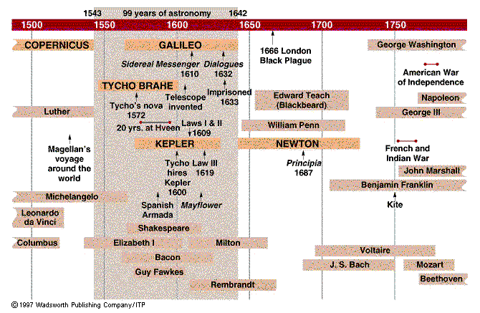

Slide 5
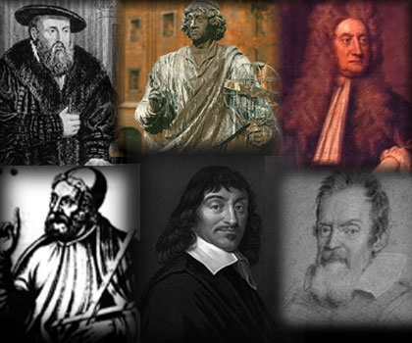
While Copernicus resolved the “place of the Earth,” Kepler only partially solved the problem of planetary motion.
Galileo continued the progress, but did not finish the work

Slide 6
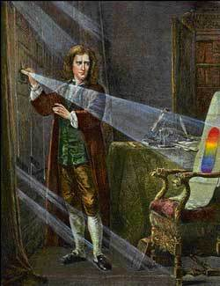
Newton finished the work of figuring out how the planets move.

Slide 7
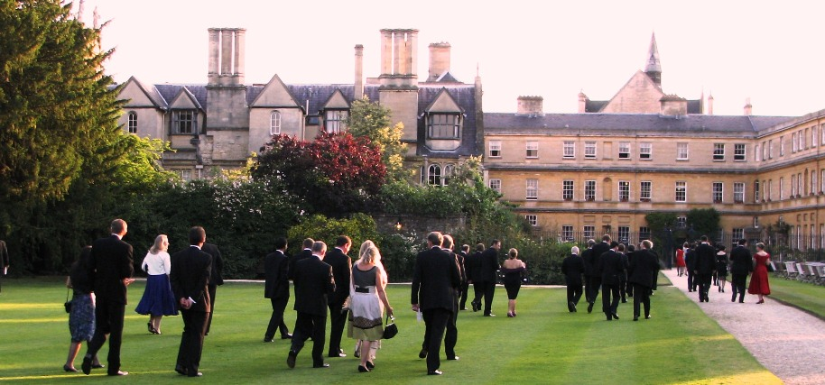
Isaac Newton
Born December 25, 1642 in Woolsthorpe, England
From a farming family
Showed academic promise from an early age and was sent to Trinity College by his uncle, and while there studied math and physics

Slide 8
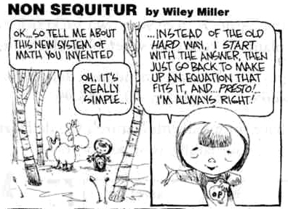
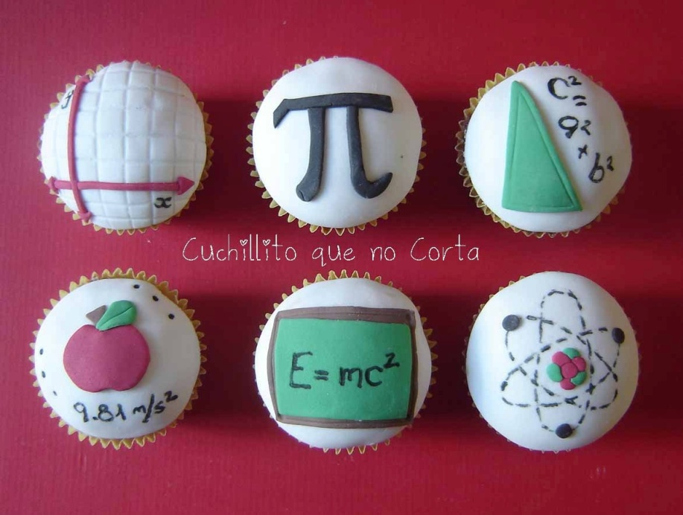
During the plagues of 1665-1666, Newton returned home and it was during those years that most of his discoveries were made, including inventing calculus.
The years after were spent refining these ideas.

Slide 9
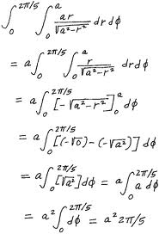
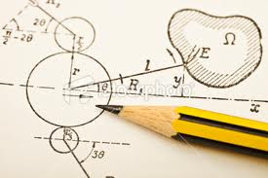
Newton used the work of his predecessors to come up with and experimentally prove his three laws of motion and the law of universal gravitation.

Slide 10
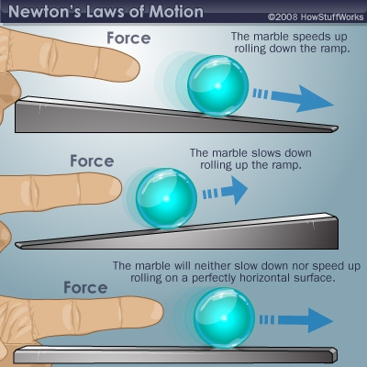
Newton’s 3 Laws of Motion
1st Law – An object in continue in its current state of motion or rest, unless acted upon by an outside force.

Slide 11
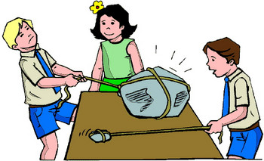
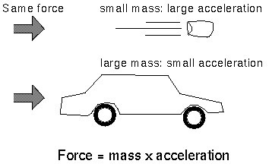
Newton’s 3 Laws of Motion
2nd Law – The force applied upon an object is proportional to the objects mass and the acceleration experienced by the object.

Slide 12
Newton’s 3 Laws of Motion
3rd Law – For every action there is an equal but opposite reaction.

Slide 13
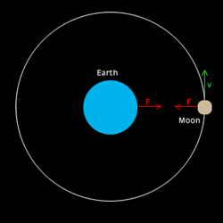
Newton’s Law of Universal Gravitation
There is a mutual attraction between objects due to the mass that each object possesses.
The more massive the
object, the more
gravitational pull it
exerts on all objects
around it.

Slide 14
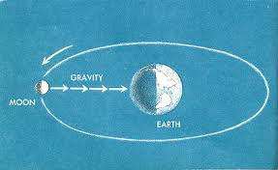
This gravitational pull is exerted by all objects, but smaller objects will have less effect when near to a larger object.
The gravitational force exists across the vacuum of space.

Slide 15
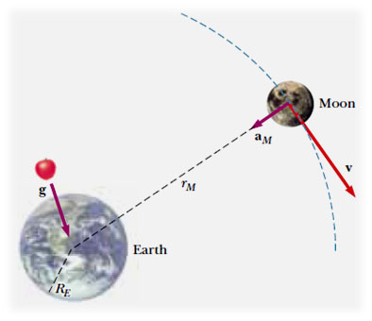
Gravity can act between very large objects across large distances, for example the Earth and Moon pull on each other.
The Sun and each of the planets pull on each other, causing the orbital paths of the planets.
Gravity between stars in our galaxy holds the galaxy together.

Slide 16
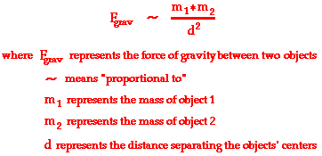
Gravity follows an inverse square relationship, where gravity between two objects increase or decrease by the square of the distances between the two objects as that distance changes.

Slide 17
Newton’s Orbital Motion
Three important ideas exist in order to comprehend Newton’s Orbital Motion:

Slide 18
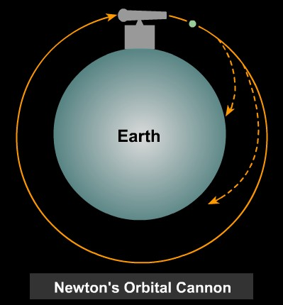
1. An orbiting object is actually falling (accelerating) toward the center of the body which it is circling.
→ If in a stable orbit, the orbiting object continuously “misses” as it is also moving forward as it falls, due to its tangential speed.

Slide 19
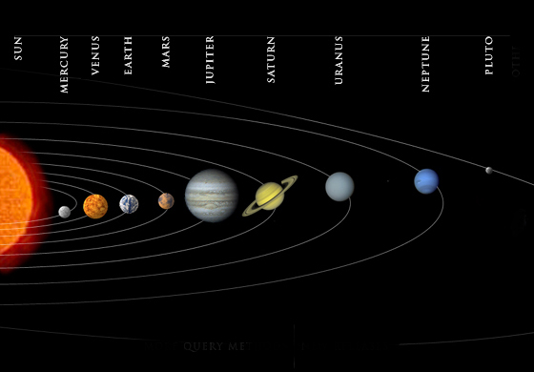
2. Objects orbiting each other actually revolve around their mutual center of mass.

Slide 20
3. There is a difference between open and closed orbits
→ Open Orbit (unbound): an orbit which allows the object to escape returning to its original starting point.
→ Closed Orbit (bound): an orbit which returns the object to its original starting point.

Slide 21
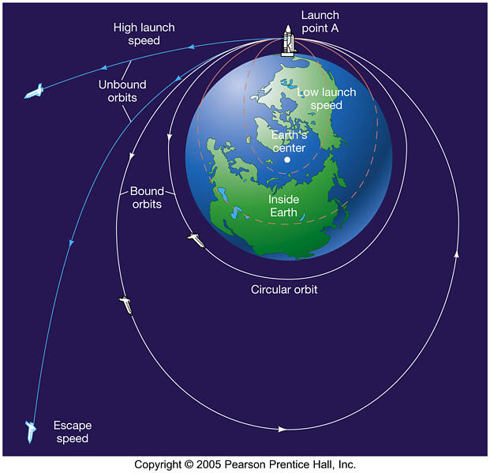

Slide 22
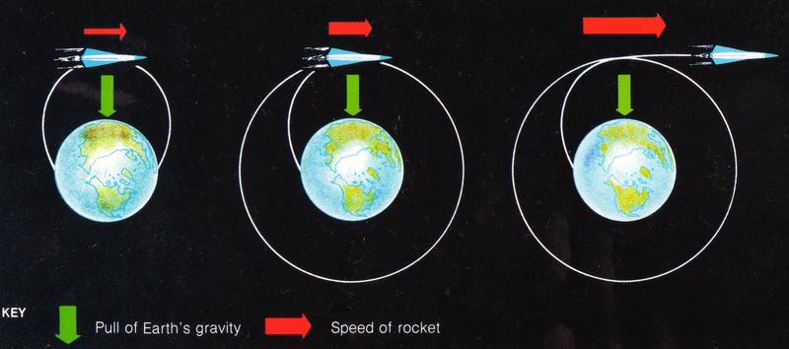
Escape velocity is the speed needed to leave a body and achieve an open orbit, and can be parabolic (just exactly escape velocity) or hyperbolic (greater than escape velocity) in shape.
Circular velocity is the speed needed to achieve a closed orbit that follows a circular path around the orbited body, and maintain a constant speed.
Any speed lower than a circular velocity, will cause the object to crash down.

Slide 24
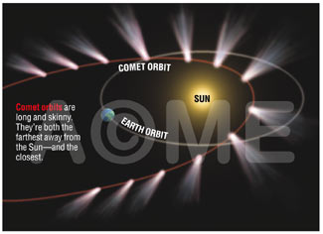
Elliptical orbits are closed orbits, where the path is in the shape of an ellipse, and the speed of the orbiting object increases as it is closest to the orbited body and decreases as it gets farther away.

Slide 25
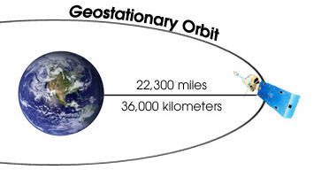
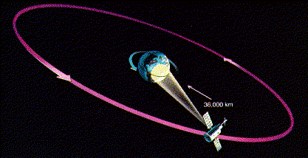
Geosynchronous orbits are achieved when an object orbits in such a way that it remains above a fixed location on the orbited object.

Slide 26
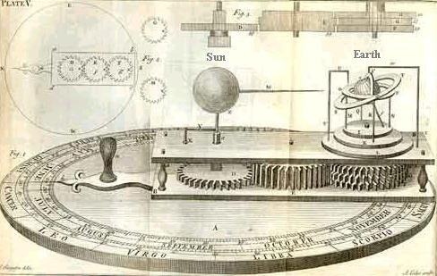
Newton’s Universe
Newton’s work and laws were general in nature so that they can be applied to many situations and many conditions.

Slide 27
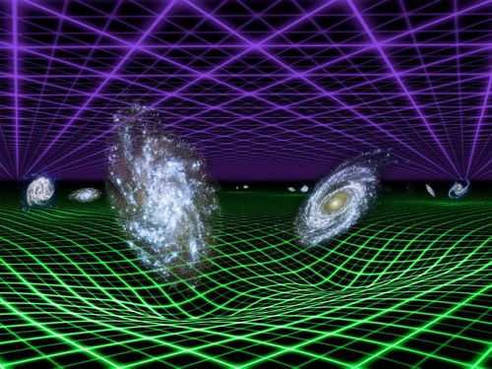
They were also predictive so that you can use them to make calculations to figure out how things will work in the future, and can be tested, and give a “cause and effect” relationship.

